Slide 1

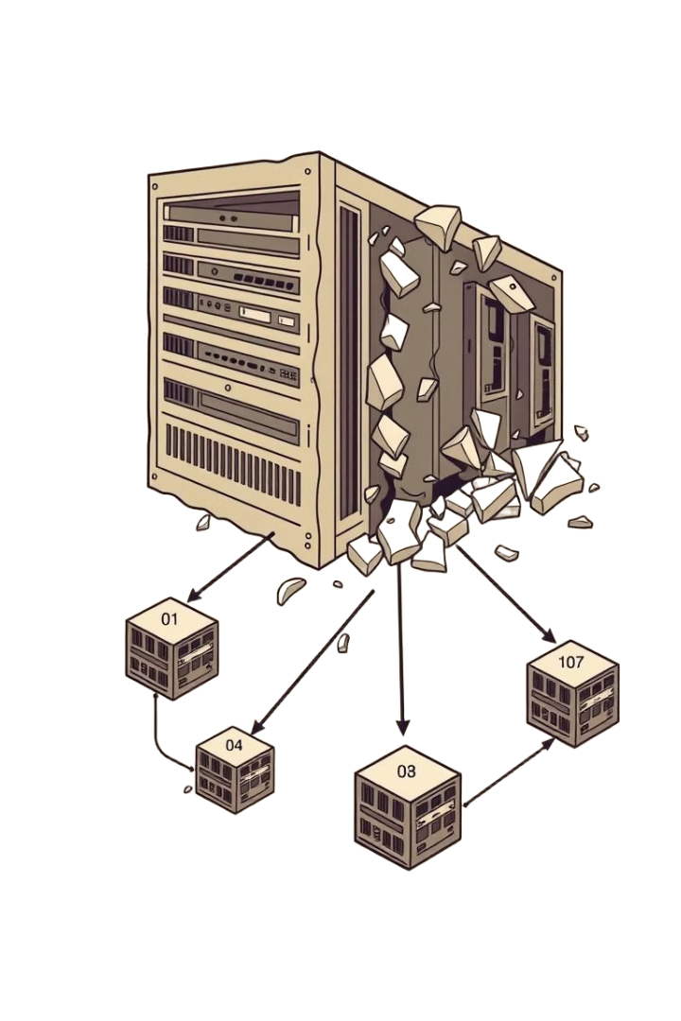
Dive into the Issue
Manually analyzing and migrating large monolithic codebases to microservices is slow, error-prone, and requires deep technical expertise. There is a need for an intelligent, automated solution that can analyze code, suggest service boundaries, and generate a clean microservice structure with minimal manual effort.
Notes:
1

Slide 2
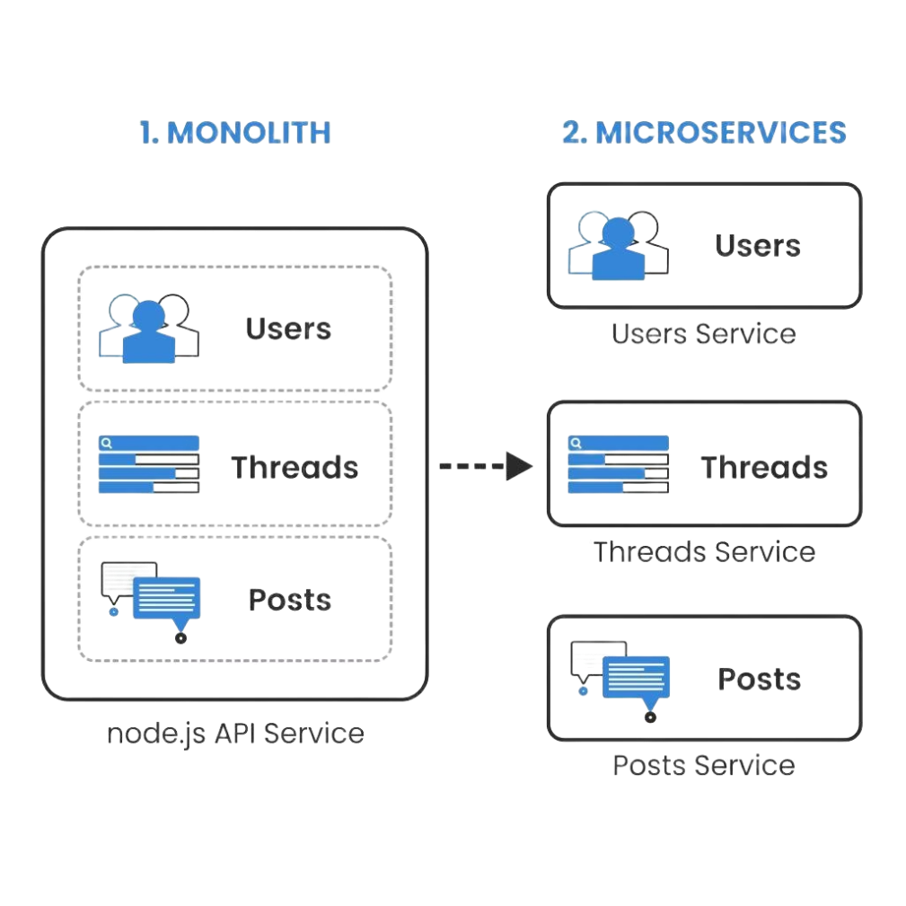
Monolithic to Microservices Migration Plan Generator
This project focuses on analyzing an existing monolithic codebase. It is systematically transforming it into a microservices architecture. The process leverages LLMs for intelligent code understanding, service decomposition, and documentation.
Notes:
2

Slide 3

Group Members
Shubham Tulsyan
Ashish Chawhan
Divyanshu Pathak
Aman Singh
Nitish Pareek
Notes:
3

Slide 4
Table of Contents
1
UBER Case Study
2
Project Objectives
3
Repository Scanning & Data Collection
4
Intelligent File Splitting
5
Generating Descriptions for Developers
6
New Microservices Architecture
7
Consolidated PDF Report
8
Future Scope
Notes:
4

Slide 5

UBER CASE STUDY
Facing scaling and complexity issues, Uber incrementally decomposed its monolith into microservices.
Key lessons: modular design, robust monitoring, and operational readiness—enabling scalability, resilience, and agility
Notes:
5

Slide 6





Project Objectives
Understand and evaluate the structure of the monolithic application
Identify logical service boundaries
Propose a microservices-based structure
Automate documentation and folder generation using LLMs
Deliver a structured PDF and folder layout for developers
Notes:
6

Slide 7

Repository Scanning & Data Collection
Scanned all files from the original monolithic repository
Report: file names, paths, and sizes
Prepared inputs for service-splitting logic using JSON
We scanned all files and metadata from the monolithic repository. Next a detailed report was generated including file names and sizes. JSON format was used to prepare inputs for service splitting logic.
Notes:
7

Slide 8
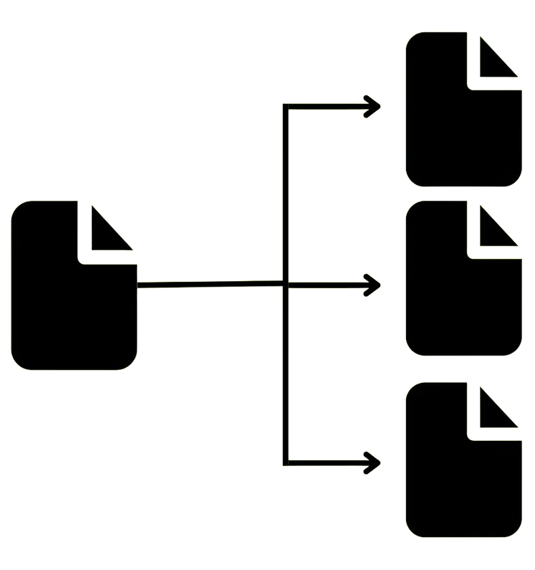
Intelligent File Splitting
Analyzed each file for splitting based on logic, coupling, and structure. Mapping original files to new paths. Each file was analyzed to determine whether it needed to be split.
Output: microservice_splits.json
Notes:
8

Slide 9
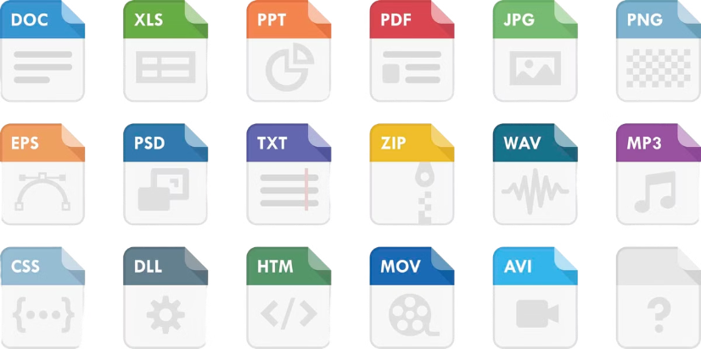
Generating Descriptions for Developers
A clear description to be generated for each new file.
Purpose: Help developers understand the responsibility of each microservice module.
Output: file_descriptions.json having human-readable summaries
Notes:
9

Slide 10
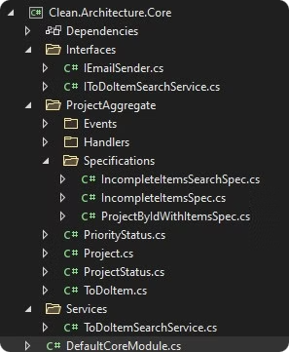
New Microservices Architecture
Combined splits and descriptions to generate a proposed folder layout.
Used LLM to format structure in a clean, readable tree format.
Output: new_microservice_structure.txt.
Notes:
10

Slide 11
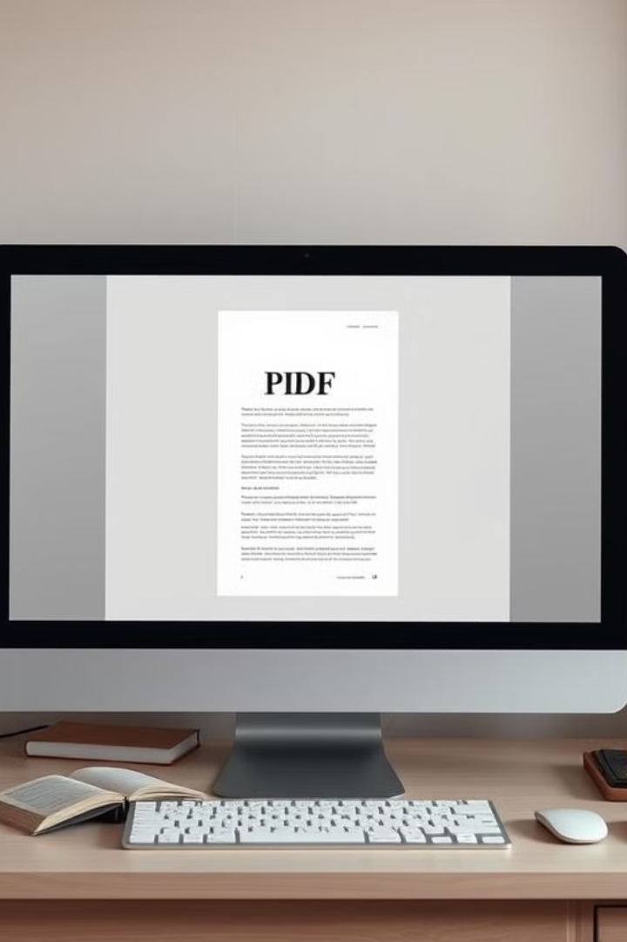
Consolidated PDF Report
Aggregated data from all outputs
Rendered a structured PDF using reportlab
Includes: Repo overview, splits, descriptions, folder structure
Data from all outputs was aggregated. A structured PDF was rendered using reportlab. Report includes repo overview, splits, descriptions, and the folder structure.
Notes:
11

Slide 12
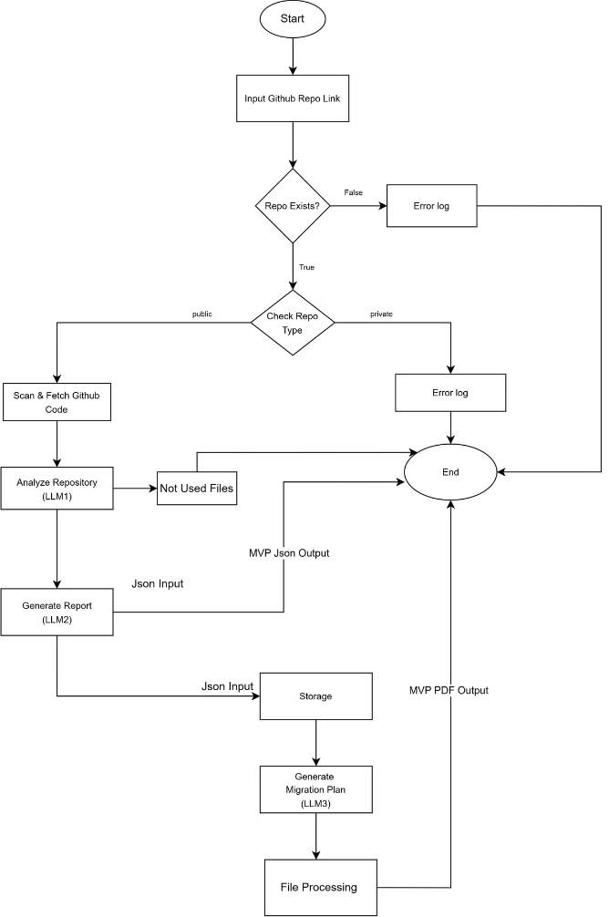
Work Flow

Slide 13

Future Scope
Refine LLM prompts for even better architectural guidance
Integrate CI/CD to automate codebase transformation
Build tools for real-time service visualization
Evaluate service-level interactions and dependencies
Notes:
12

Slide 14
THANK YOU
Notes:
13

